Slide 1

PnP Community Sample List formatting - Neumorphic design
André Lage
Twitter: @aaclage GitHub: https://github.com/aaclage

Slide 2
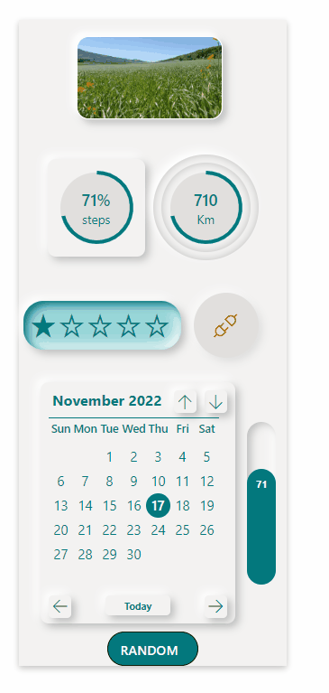
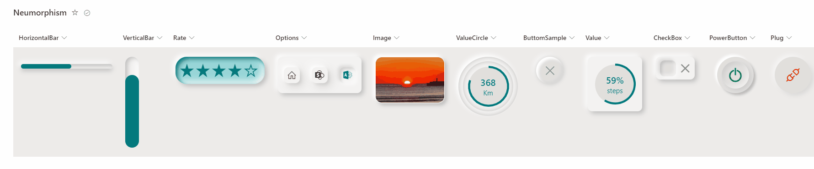
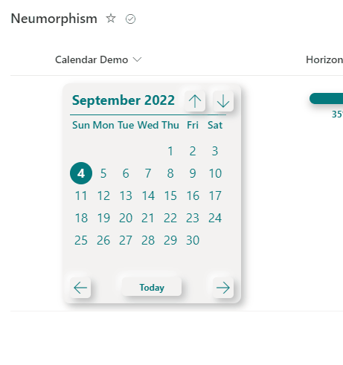
List Formatting – Samples
Kristine Kolodziejski (inspire on topic)

Slide 3

Analyze Neumorphic design
Understand, Investigate, evaluate and Test.
Analyze concept and goal to achieve.
HTML/CSS skills review.
Simulate 3D look and fell and test over and over.
JSON Column formatting Samples
Buttons
Option
Rate
Image
Doughnut https://github.com/pnp/List-Formatting/tree/master/column-samples/number-doughnut-chart
Bars
Calendar
Concept
box-shadow
PoC
JSON
Formatting
Formatting Catalog
Tetsuya Kawahara (Great samples)

Slide 4
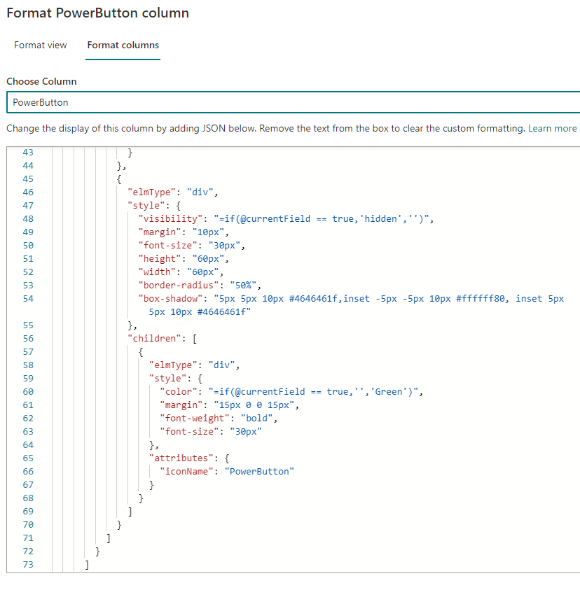
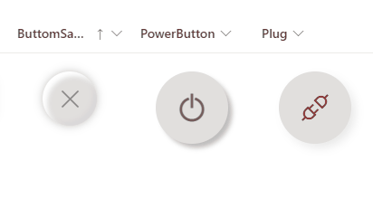
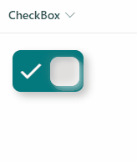
List Formatting – Buttons sample
Goal: Provide 3D look and feel that button when pressed.
Simulate real actions like pressing energy button and associated shadows.
Field type: Yes/No.

Slide 5
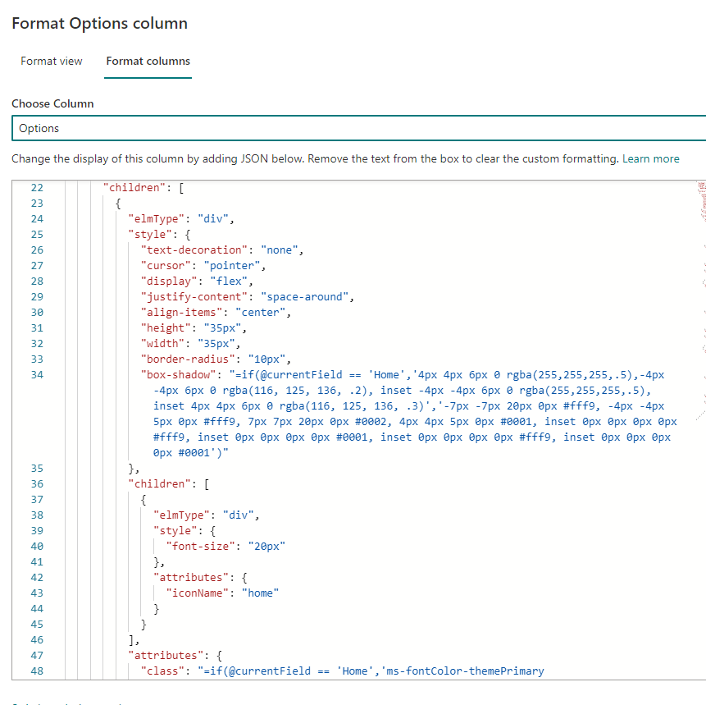
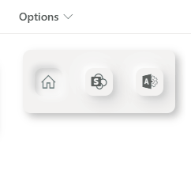
List Formatting – Option sample
Goal: Selection of options with button 3D press effect.
Shadow box simulate option selected as pressed when other options are available.
Field type: Choice.

Slide 6
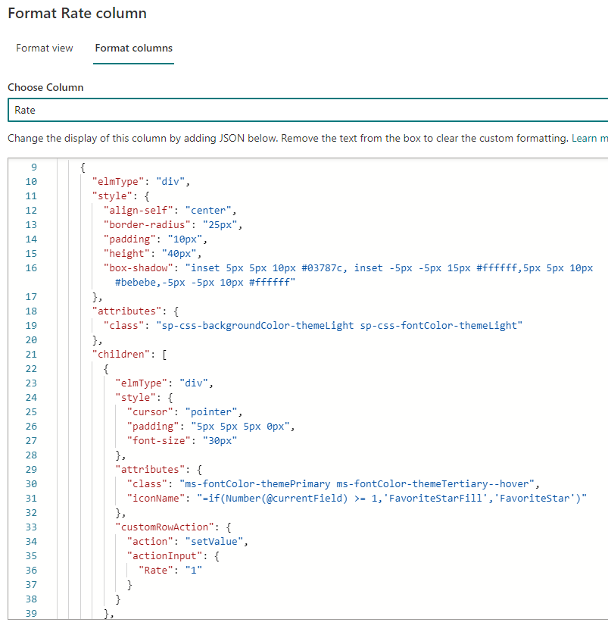
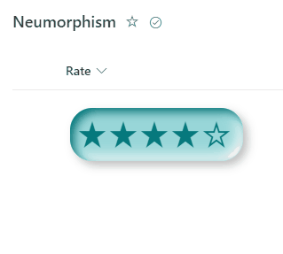
List Formatting – Rate sample
Goal: Rate experience with delimited 3D area.
Shadow effect inside control.
Field type: Number from 1 - 5

Slide 7
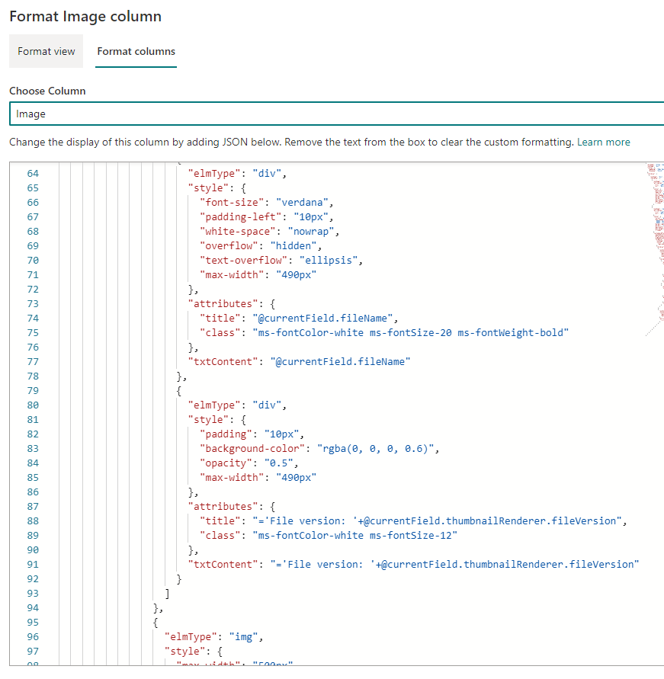
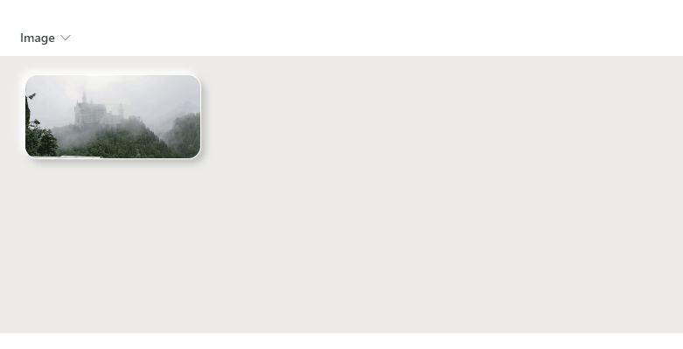
List Formatting – Image sample
Goal: Provide 3D feeling that image has space between background.
Provide opacity on hover image to provide description.
Field type: Image

Slide 8
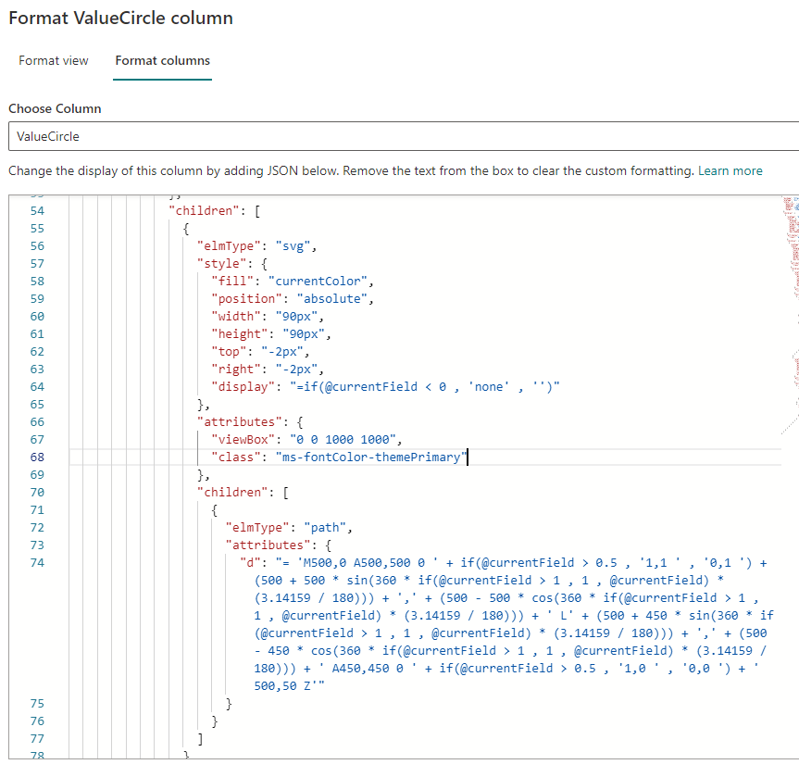
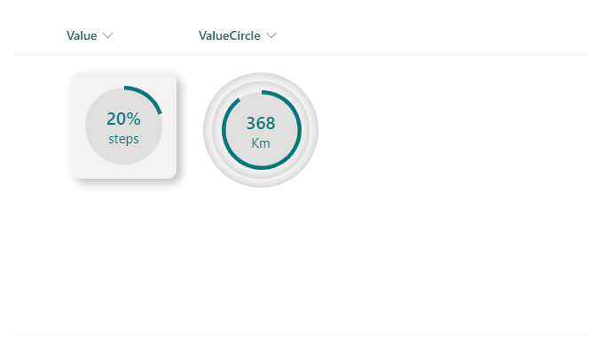
List Formatting – Doughnut sample
Goal: Generate Doughnut with border shadows.
SVG + Math calculation to draw Doughnut.
Great work from Tetsuya Kawahara (@techan_k)
https://github.com/pnp/List-Formatting/tree/master/column-samples/number-doughnut-chart
Boxes, Circles areas with shadows.
Field type: Single line of Text

Slide 9
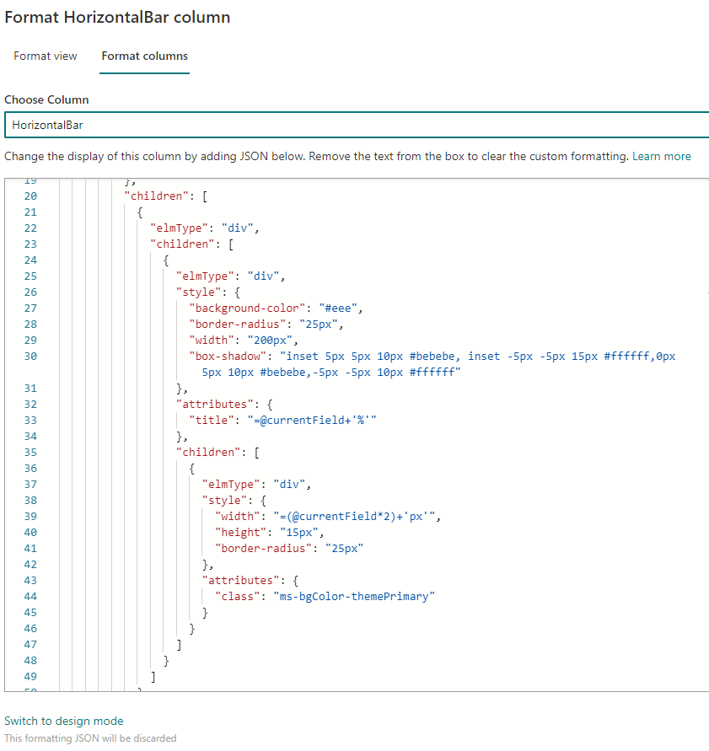
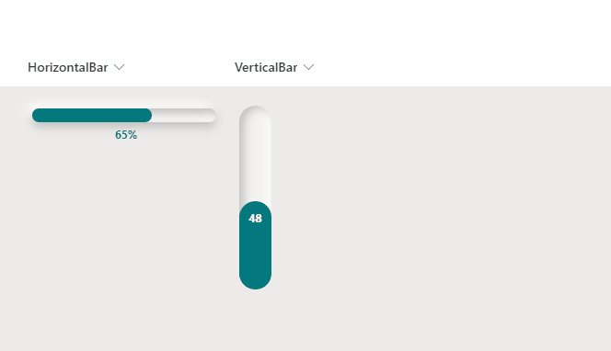
List Formatting – Bars sample
Goal: Generate vertical/horizontal Bar percentage.
Shadows to include depth on Bars status.
Field Type: 0.1 - 1

Slide 10
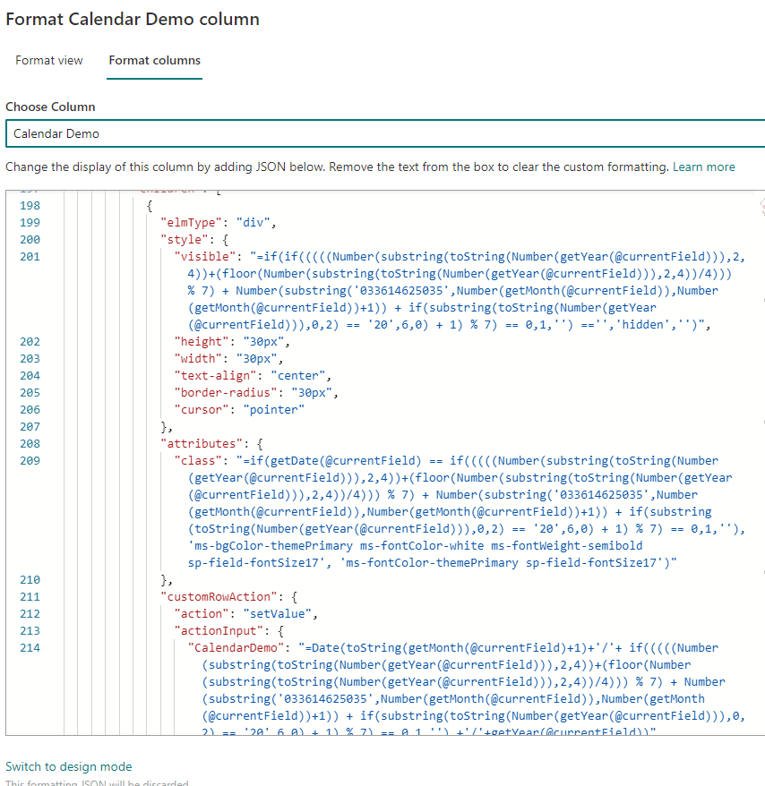
List Formatting – Calendar sample
Goal: Select date in column calendar format.
Date Operators: Date, getDate, getMonth, getYear, addDays
Math Formula to calculate the day of week.

Slide 11
Demo

Slide 12
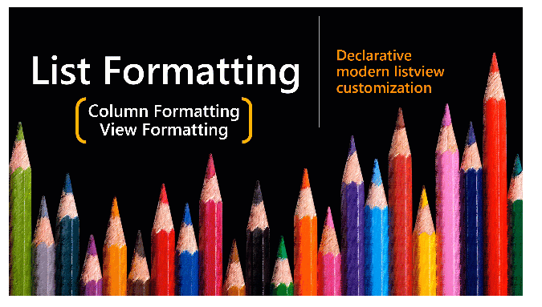
Samples – List Formatting
Thank you
https://github.com/pnp/List-Formatting

